Slide 1

Undergraduate Analytics Minors
May 13, 2021
Jiang Li, Nimet Alpay, Laurie Crawford

Slide 2
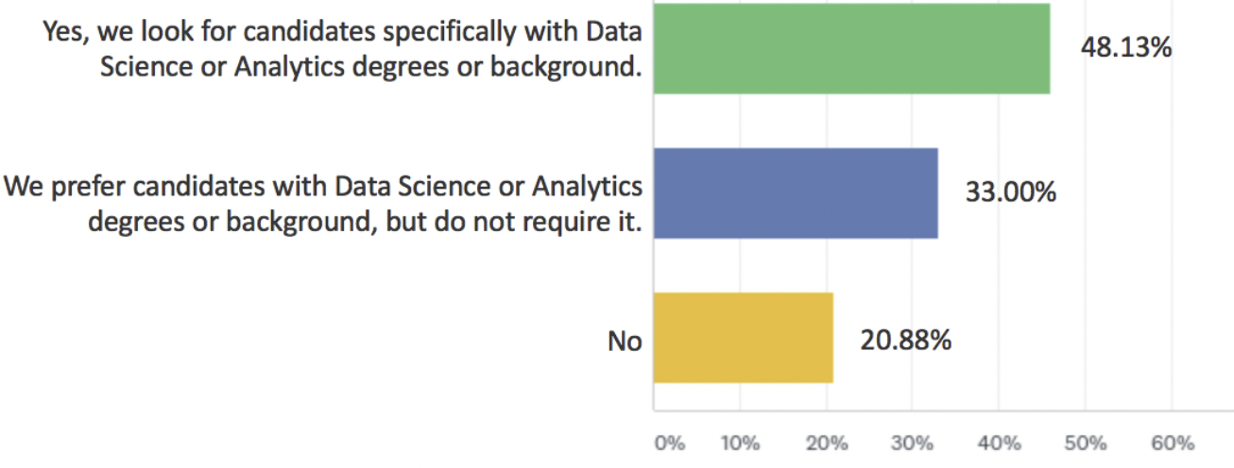
DATA/BUSA Minors Goals
Provide a valuable skill option to all Franklin undergraduates.
Cover industry standard tools (Excel, SQL, Tableau, Python, R) as determined by jobs research.
Cover essential knowledge units for industry relevance.
Reuse as much curriculum as possible.
Do you look for undergraduate job candidates with analytics/data science background?
Industry Survey, 2021
Source: Industry Survey, ACM Data Science Task Force, 2021 https://www.acm.org/binaries/content/assets/education/curricula-recommendations/dstf_ccdsc2021.pdf

Slide 3

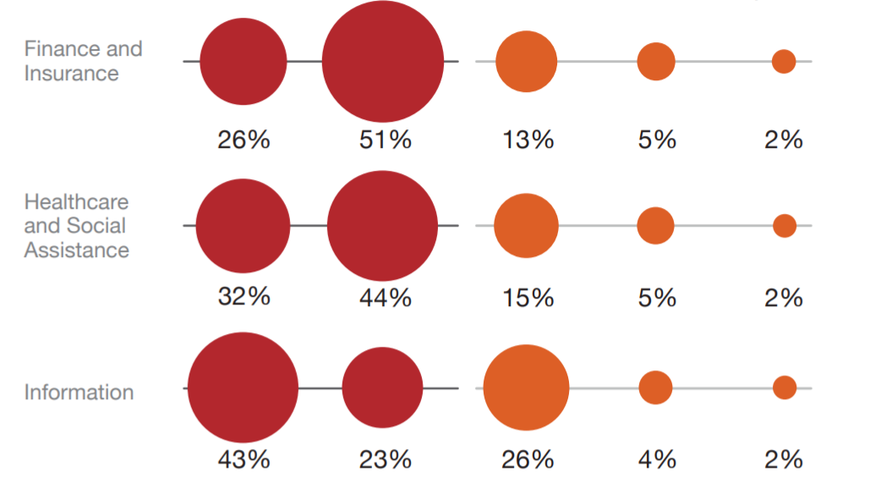
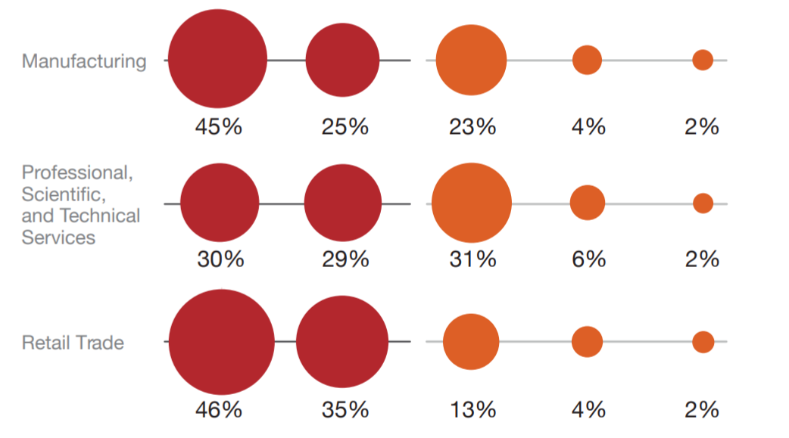
Analytics Skills Make Students Highly Marketable
Business Analytics minor target
Data Analytics minor target
Source: Business Higher Education Forum 2017 https://www.bhef.com/sites/default/files/bhef_2017_investing_in_dsa.pdf

Slide 4
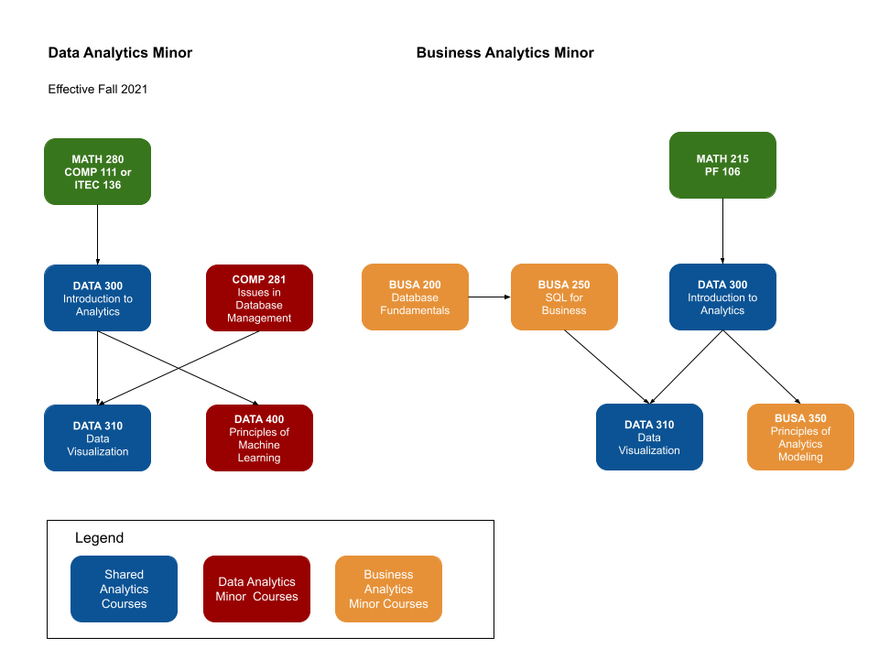
Curriculum

Slide 5
Prerequisites and Schedules
COMP 281 – Database Management Systems (existing course, 4 credit hrs, LF Laurie Crawford )
Schedule: 21FA, onlineR
DATA 300 – Introduction to Analytics (redesigned from INFA 300, 4 credit hrs, LF Jiang Li)
Prerequisites: MATH 215 or MATH 280, PF 106 or COMP 111 or ITEC 136
Schedule: 21FA onlineU
Notes: a direct substitute for INFA 300; a major elective in many business-school bachelor programs
DATA 310 – Data Visualization (redesigned from INFA 350, 4 credit hrs, LF Nimet Alpay)
Prerequisites: DATA 300, BUSA 250 or COMP 281
Schedule: 22SP
Note: a direct substitute for INFA 350
DATA 400 – Principles of Machine Learning (same as COMP 411, 4 credit hrs, LF Jiang Li)
Schedule: 21FA, onlineR

Slide 6
BUSA 200 – Database Fundamentals
(new course, a general education course to replace PF 108, 2 credit hrs, LF Laurie Crawford)
Prerequisites: PF 121 or PF 321
Schedule: 21FA onlineF
BUSA 250 – SQL for Business (new course, 2 credit hrs, LF Jiang Li)
Prerequisites: BUSA 200, MATH 215 or MATH 280
Schedule: 21FA onlineH
BUSA 350 – Principles of Analytics Modeling (redesigned from INFA 420, 4 credit hrs, LF Jiang Li)
Prerequisites: DATA 300
Schedule: 21FA onlineH
Note: a direct substitute of INFA 420

Slide 7
Suggestions
1. Please let the INFA students know INFA 300 and INFA 420 will be replaced by DATA 300 and BUSA 350 from Fall 2021. Also, BUSA 350 is a 6-week course.
2. If students are interested in analytics but hesitate to take DATA 300, please let them know this course is to introduce analytics principles, and the hands-on course design using McGraw Hill's interactive textbook and web-based assignment platform can help them to learn much smoothly.
3. Please clarify the differences between BUSA 200 and BUSA 250: The former is an introduction to database fundamentals. The zyBooks, which is an interactive platform similar to McGraw Hill's , has been applied. The latter focuses on the hands-on applications of SQL in real-world business problem. A convenient web-based database interface will be used.

